Slide 1
Policy Improvement

Slide 2
Objectives
Generalized Policy Iteration (GPI)
Slippery Walk Seven environment
Monte Carlo control
SARSA
On-policy and Off-policy learning
Q-Learning
Double Q-Learning
SARSA(𝜆)
Q(𝜆)
Comparison
Model-based Reinforcement Learning
Dyna-Q
Learned transition model
Trajectory sampling
Exercise

Slide 3

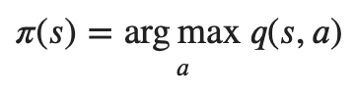
Generalized Policy Iteration (GPI)
Instead of estimating the state-value function 𝑉(𝑠) , we estimate the action-value functions 𝑄(𝑠,𝑎)
in order to see the value of actions without having to use the MDP
After we obtain the estimation, we use it to improve the policy
similar to what we did in the policy-iteration algorithm of dynamic programming
we evaluate, we improve, then evaluate the improved policy, then improve on this improved policy, and so on
The improvement is done by making the policy greedy with respect to the current value function
we have the action-value function estimation
no model is needed to construct the greedy policy
This pattern is called Generalized Policy Iteration (GPI)
an architecture that any reinforcement learning algorithm fits under

Slide 4
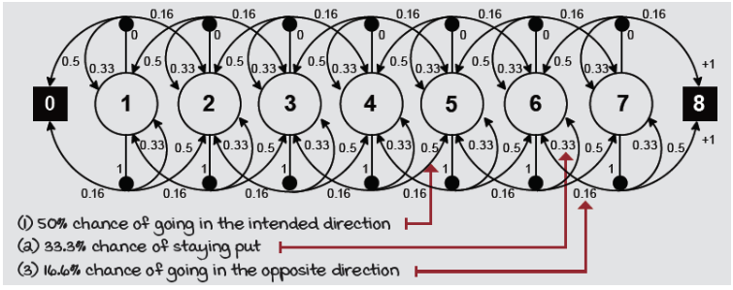
Slippery Walk Seven environment
We use an environment called slippery walk seven (SWS)
a walk in a single-row grid-world environment
seven non-terminal states
it’s slippery: action effects are stochastic
The environment is noisy, but the actions the agent selects make a difference in its performance

Slide 5
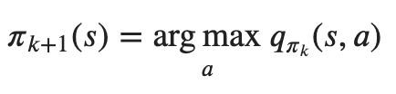

Monte Carlo control (1)
Policy improvement can be done by constructing each new policy 𝜋_{𝑘+1} as the greedy policy with respect to the new value function 𝑞_{𝜋𝑘}
The policy improvement theorem then applies to:
this assures that each 𝜋_{𝑘+1} is better than 𝜋_{𝑘}
converges to the optimal policy (and optimal value function)
First, we need to estimate 𝑄(𝑠,𝑎) instead of 𝑉(𝑠)
in order to know what the best action is to take from a state
we cannot use the MDP
we have to estimate from samples: let’s use first-visit Monte Carlo prediction
Second, we need to explores
we can use a decaying epsilon-greedy action-selection strategy

Slide 6
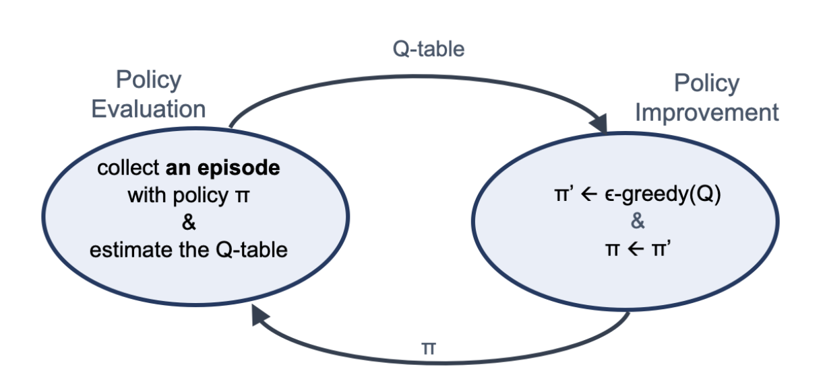
Monte Carlo control (2)
We alternate a single MC evaluation step and a single decaying epsilon-greedy action-selection improvement step
See “monte-carlo-control.ipynb”

Slide 7
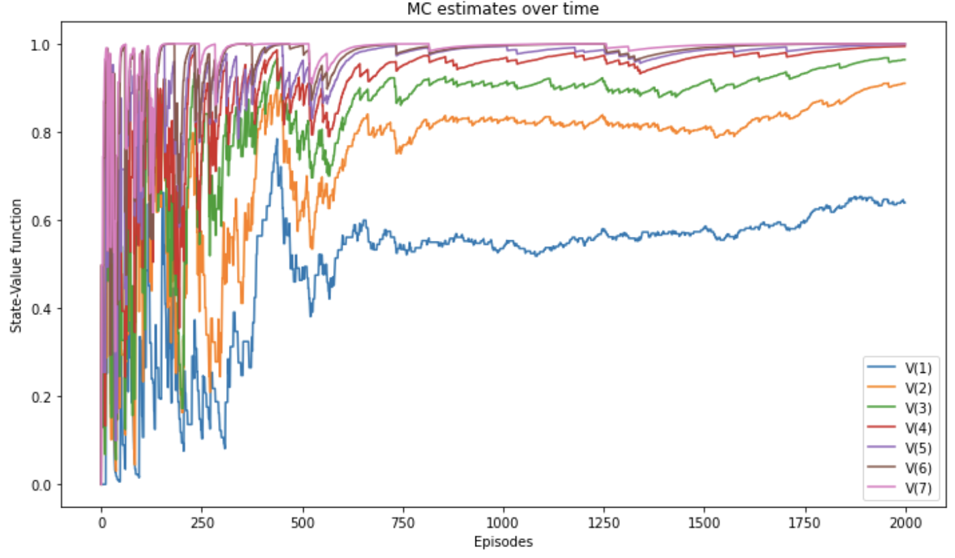
Monte Carlo control (3)

Slide 8

SARSA (1)
Monte Carlo is offline in an episode-to-episode sense
we must wait until we reach a terminal state before we can make any improvements
notice how the estimates have high variance
It’s straightforward to use temporal-difference prediction for the evaluation phase
we now have a different algorithm, the well-known SARSA agent
See “sarsa.ipynb”
see how SARSA has less variance than MC
it takes pretty much the same amount of time to get to the optimal values

Slide 9
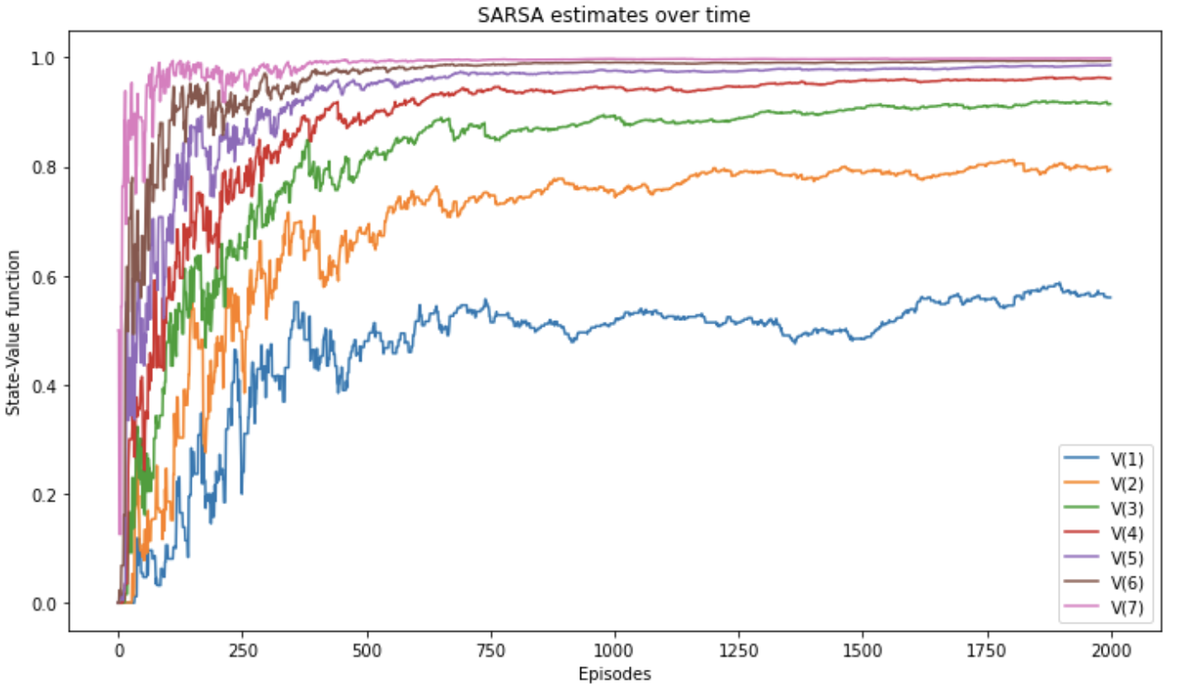
SARSA (2)

Slide 10
On-policy and Off-policy learning
In SARSA and MC agent learns the same policy used for generating experience
on-policy learning
it is excellent: we learn from our own mistakes
But we learn from our own current mistakes only
what if we want to learn from our own previous mistakes?
what if we want to learn from the mistakes of others?
Off-policy learning
sort of "learning from others”
agent learns a different policy from the one used to generate experiences
There are two policies:
behaviour policy used to generate experiences
target policy, the policy we’re learning about

Slide 11

Q-Learning (1)
Q-learning is similar to SARSA, but with a off-policy approach
SARSA uses the action taken in the next state to calculate the target
Q-learning uses the action with the maximum estimated value in the next state, despite the action taken
See “q-learning.ipynb”
see how faster the estimates track the true values
however the estimates are higher and jump around aggressively
It often overestimates the value function
it uses maximum over estimates as an estimate of the maximum
imagine a function whose actual values are all zeros, but the estimates have bias (0.11, 0.65, –0.44, –0.26, and so on)
we know the maximum is zero, but the maximum over the estimates is 0.65
maximization bias

Slide 12
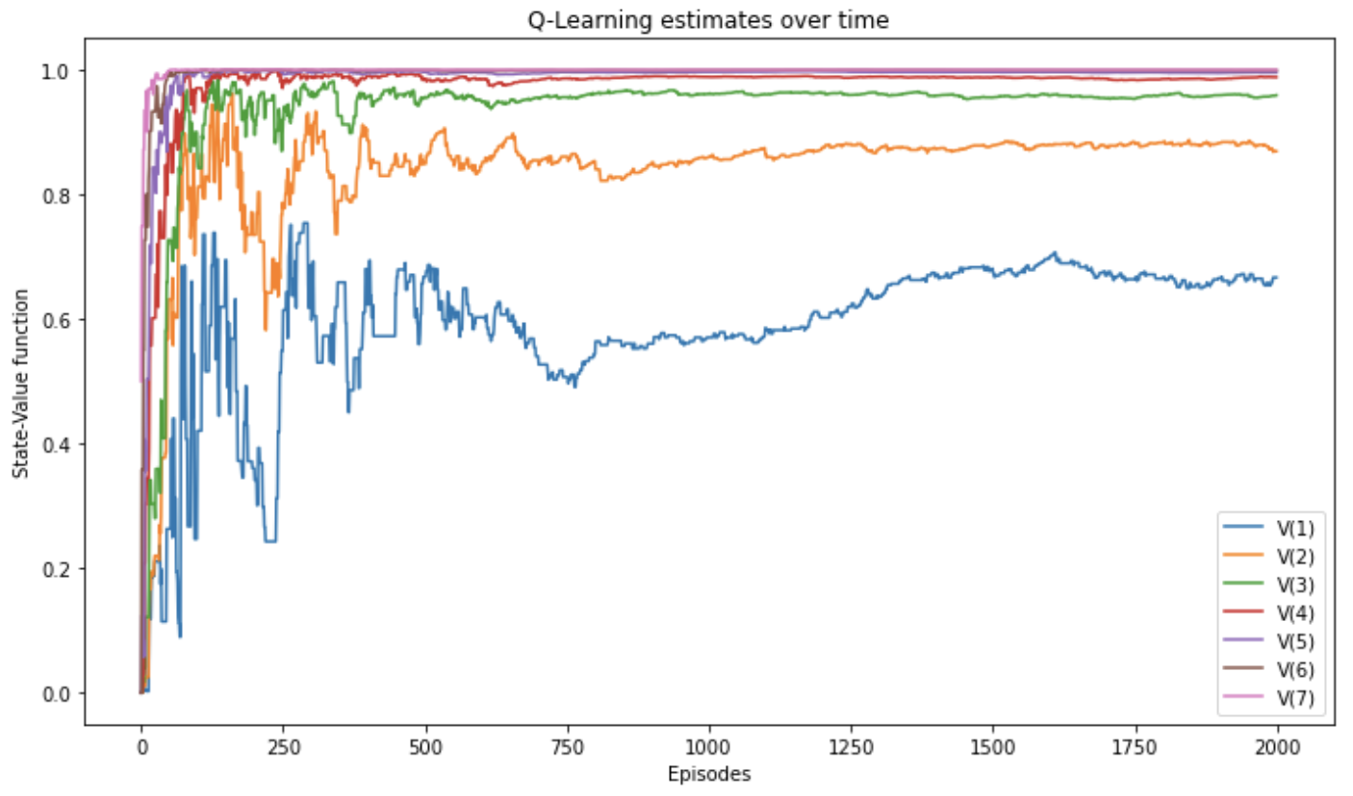
Q-Learning (2)

Slide 13
Double Q-Learning (1)
One way of dealing with maximization bias is to maintain two Q-value functions
𝑄_{𝐴} and 𝑄_{𝐵}, each one gets update from the other for the next state
the update consists of finding the action 𝑎∗ that maximises 𝑄_{𝐴} in the next state, then use 𝑎∗ to get the value of 𝑄_{𝐵}(𝑠′,𝑎∗) in order to update 𝑄_{𝐴}(𝑠,𝑎)
We can think of this similar to cross-validation:
one Q-function estimates will help us validate the other Q-function estimates
We’re splitting the experience between two functions and this slows down training
See “double-q-learning.ipynb”
it is slightly slower than Q-learning to get the estimates to track the optimal state-value function
but it does so in a much more stable manner
there’s still a bit of over-estimation, but it’s controlled

Slide 14
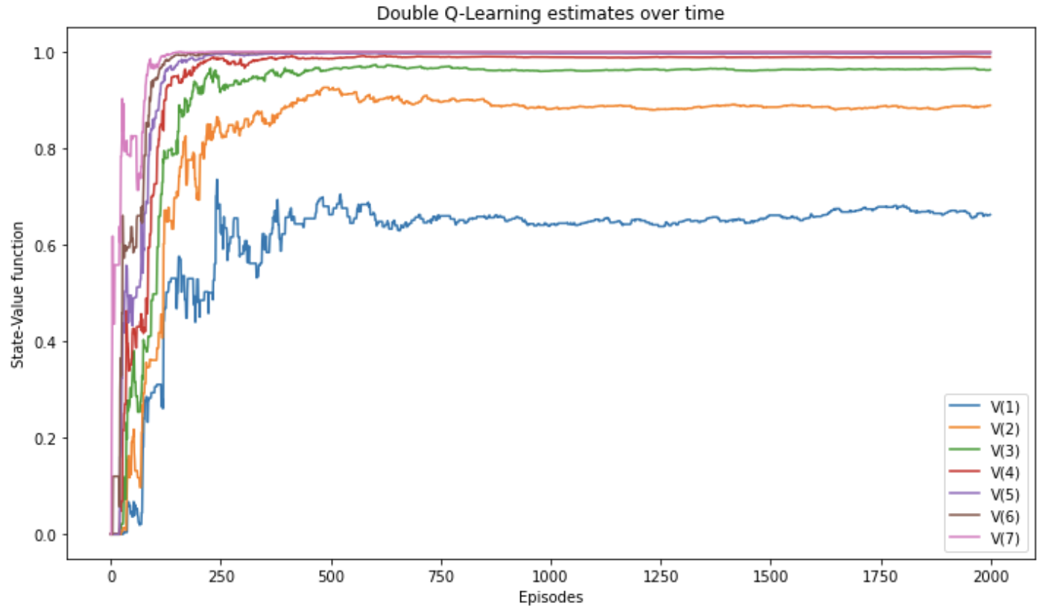
Double Q-Learning (2)

Slide 15
SARSA(𝜆) (1)
Instead of using a one-step bootstrapping target, it uses the 𝜆-return
use an eligibility matrix for tracking visited state-action pairs
when agent tries a state-action pair
the trace for this pair is incremented by one
Multiple ways of tracing state-action pairs responsible for a reward
in a loop the agent tries the same state-action pair several times
should we make this pair "more" responsible for rewards obtained?
or should we make it just responsible?
accumulating trace
allows trace values higher than one
replacing trace
clips eligibility traces to a maximum value of one
The following figure shows two strategy applied to the SWS environment

Slide 16
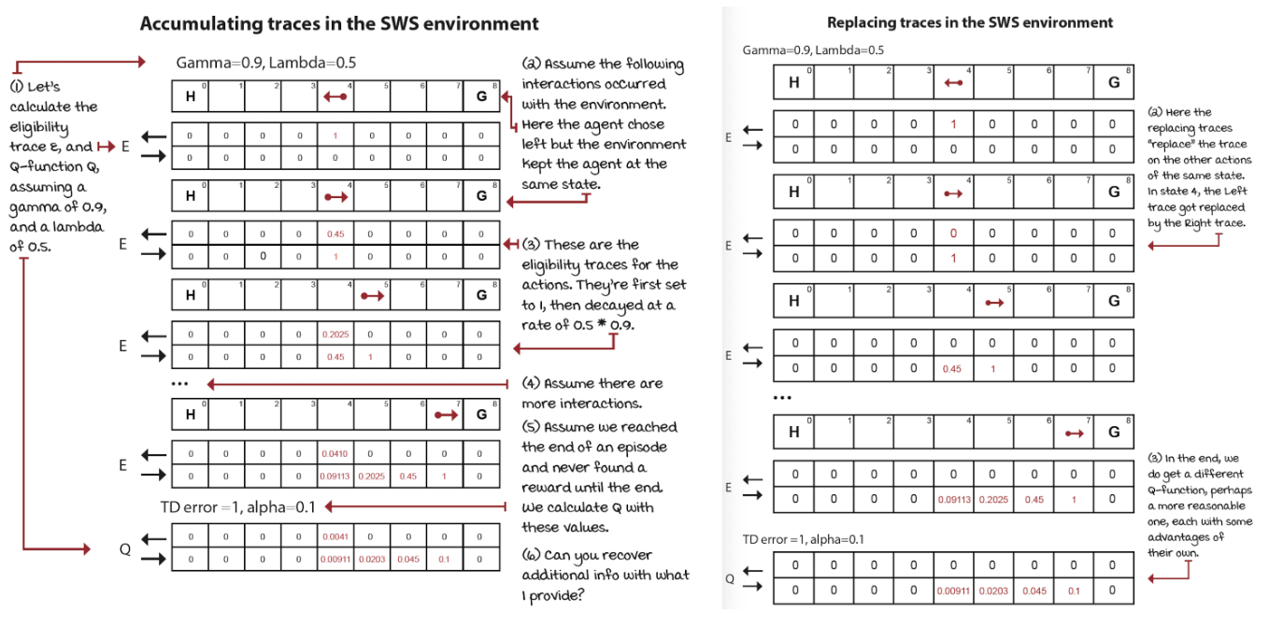
SARSA(𝜆) (2)
See “sarsa-lambda.ipynb”

Slide 17
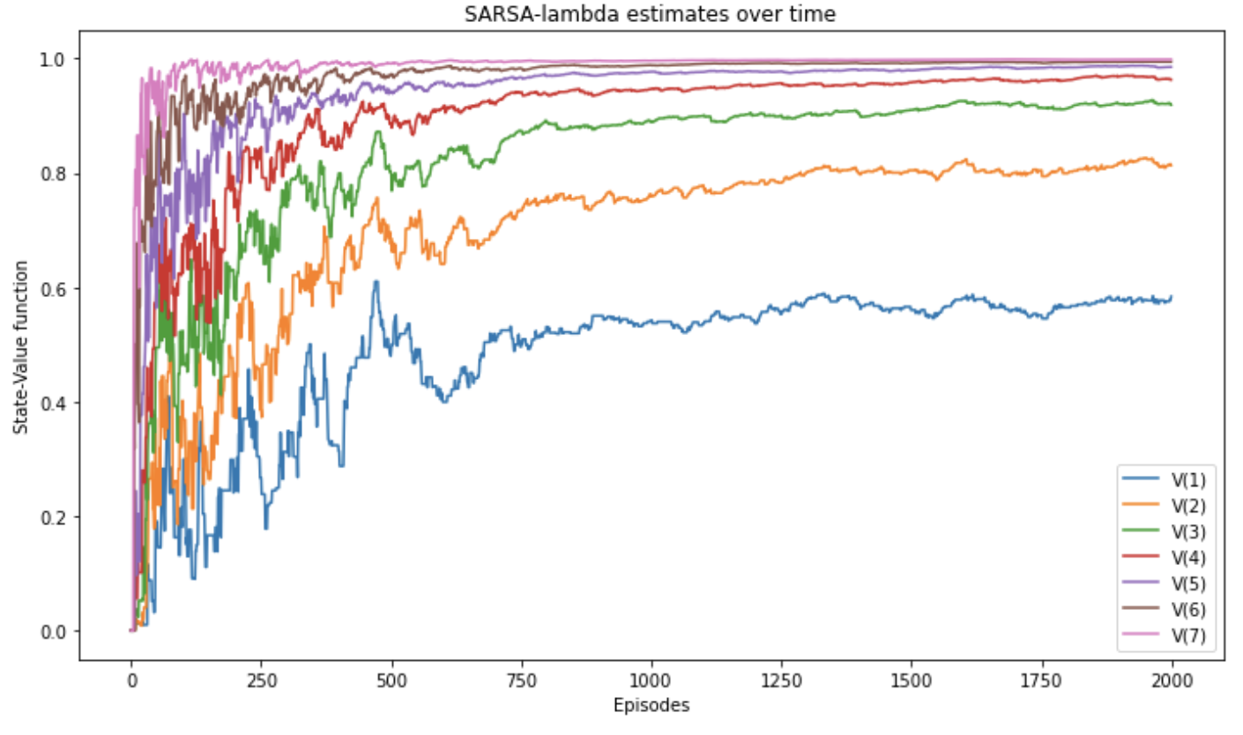
SARSA(𝜆) (3)

Slide 18
Q(𝜆) (1)
Extension of Q-learning that uses the 𝜆-return for evaluation
See “q-lambda.ipynb”

Slide 19
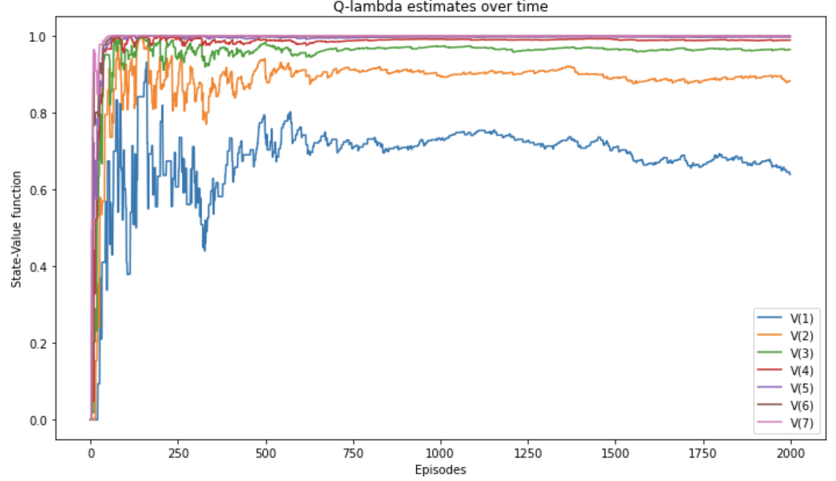
Q(𝜆) (2)

Slide 20
Comparison (1)
In the next plot, we’re looking at the state-value function estimation error
we user the mean absolute error across all estimates from their respective optimal
notice how quickly Q-learning drops near zero, but also how double Q-learning gets to the lowest error first
See “comparison.ipynb”

Slide 21
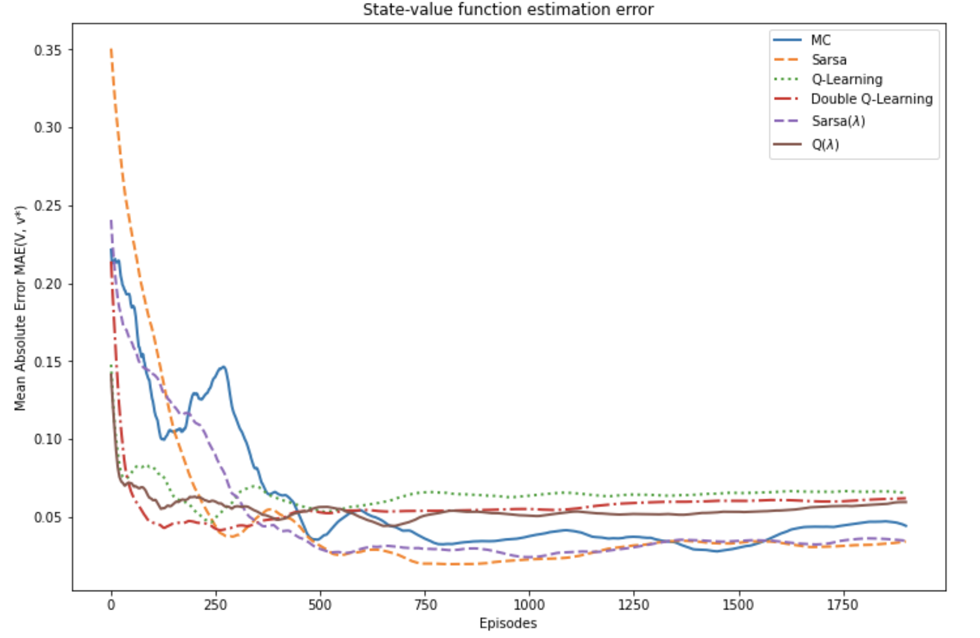
Comparison (2)

Slide 22
Model-based Reinforcement Learning
Planning algorithms
dynamic programming: value iteration and policy iteration
require a model of the environment
Learning algorithms
model-free methods: doesn’t require MDP internals
Not requiring the MDP in advance is a of crucial importance
often the MDP is challenging to obtain in advance or it is even impossible to obtain
imagine to represent the game of Go with its 10.170 possible states
StarCraft II game with 101.685 states
However, what if we learn a model as we interact with the environment?
we explore the environment (like model-free methods), but we learn a model of the environment from these interactions
by exploiting the learned model (like dynamic programming), agents often require fewer experience to learn optimal policies

Slide 23
Dyna-Q (1)
Interleave a model-free method (e.g. Q-learning) and a planning method (e.g. value iteration)
use experiences sampled from the environment
use experiences sampled from the learned model
We keep track of the transition and reward functions as three-dimensional tensors indexed by state (s), action (a), and next state (s’)
keeps count of the number of times we’ve seen the tuple (𝑠,𝑎,𝑠′)
indicating how many times we arrived at state 𝑠′ from state 𝑠 when selecting action 𝑎
holds the average reward we received on the tuple (𝑠,𝑎,𝑠′) indicating the expected reward when we select action 𝑎 on state 𝑠 and transition to state 𝑠′

Slide 24
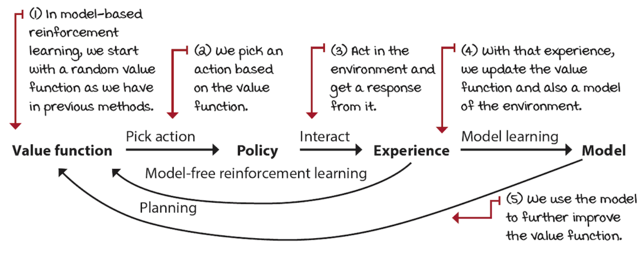
Dyna-Q (2)
See “dyna-q.ipynb”

Slide 25
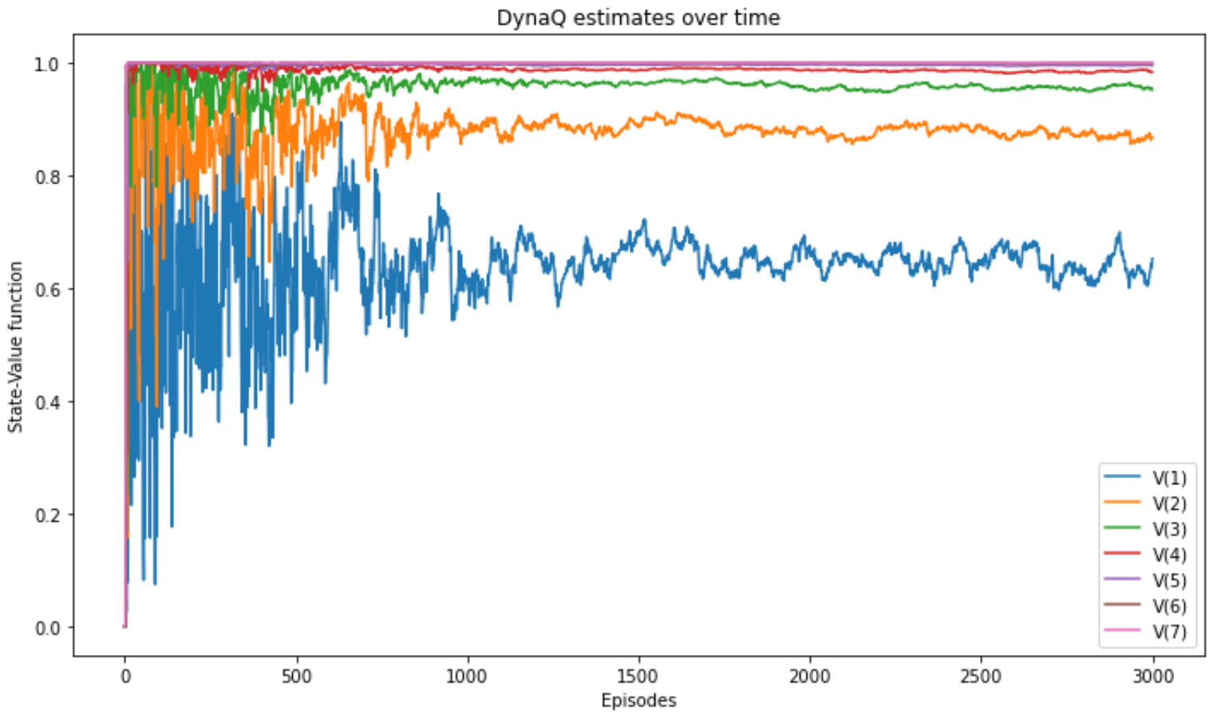
Dyna-Q (3)

Slide 26
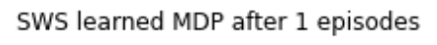
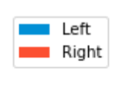

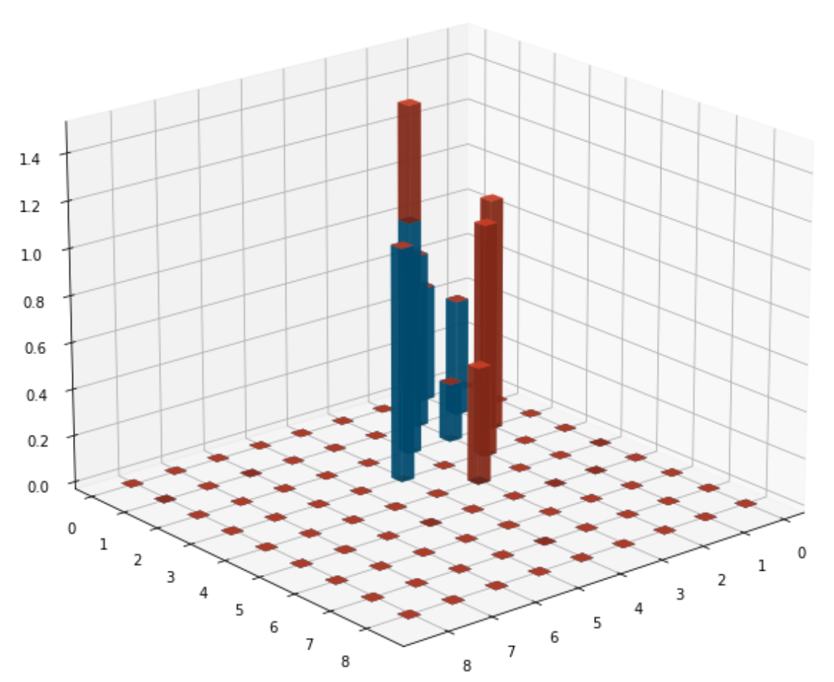
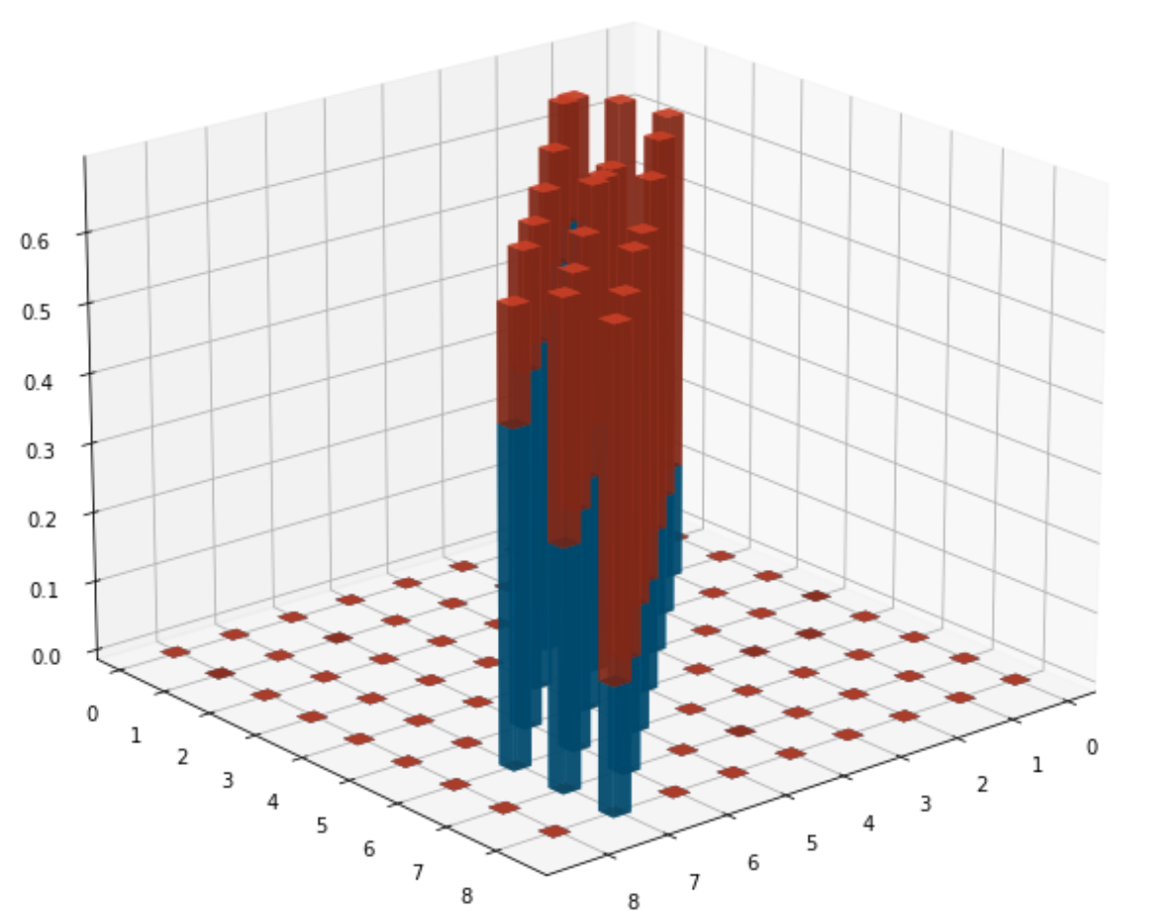
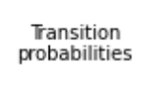
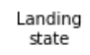
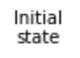
Learned transition model
We can try to understand the learned transition model
bar heights are the transition probabilities
At the end, the probabilities are good enough and describe the MDP correctly
this is a simple environment, so the agent can gather enough experience quickly

Slide 27
Trajectory sampling (1)
In Dyna-Q, during the planning phase, we sample from the state-action pairs that have been visited
so we don’t waste time with state-action pairs about which the model has no information
however, from those pairs, we sample a uniformly at random
We can be more effective if we used a state that we expect to encounter during the current episode
planning for the immediate future is the smarter approach
See “trajectory-sampling.ipynb”
We can compare the differences in sampling the model of DynaQ and Trajectory sampling
plot the states that were sampled by the planning phase of the two algorithms
and the actions selected in those states
See “sampling-comparison.ipynb”

Slide 28
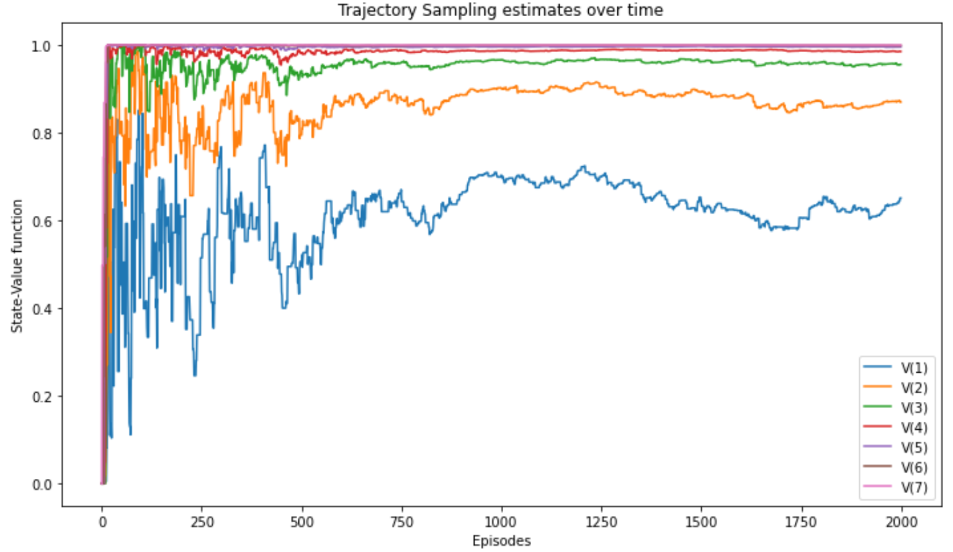
Trajectory sampling (2)

Slide 29
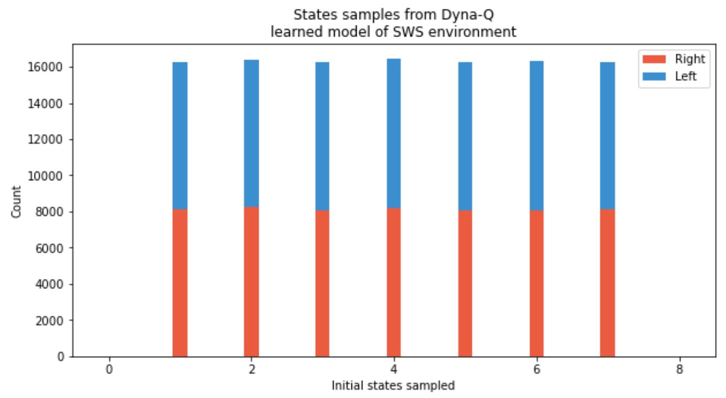
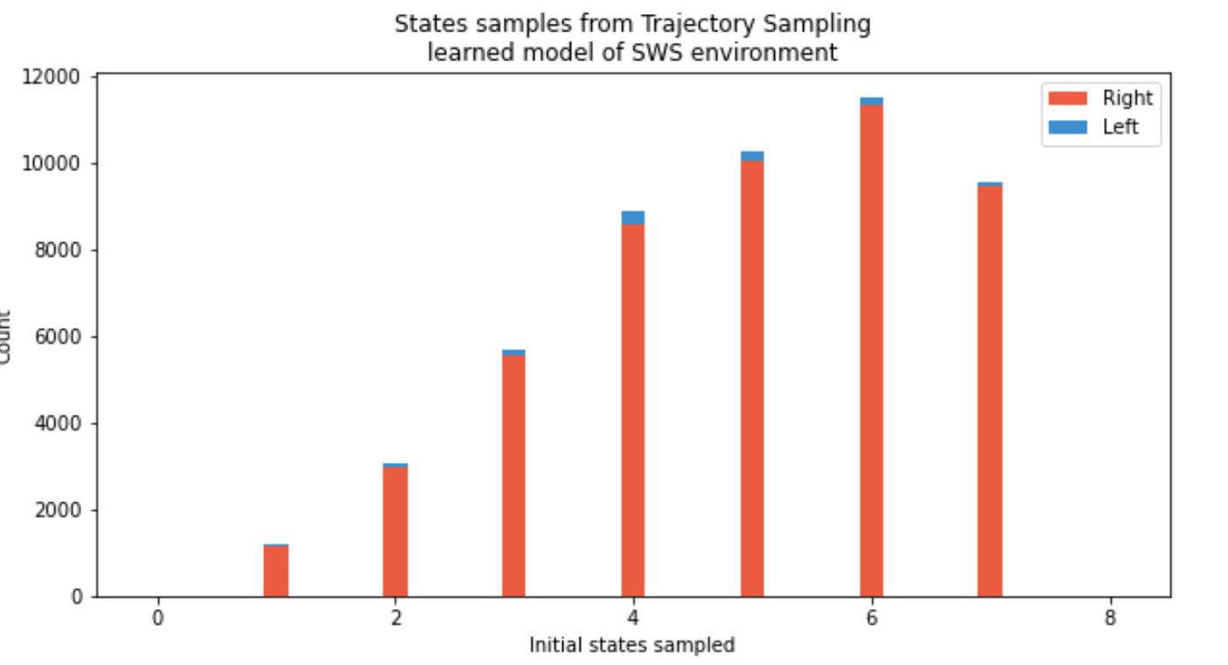
Trajectory sampling (3)
Dyna-Q samples uniformly at random states and also the actions taken
Trajectory sampling samples the model to improve greedy action selection
states sampled are skewed toward the goal state
right action is sampled far more than the left action across the board
Trajectory sampling lands on the goal state far more often, therefore experiencing non-zero rewards from the model more frequently

Slide 30
Exercise
1 - Train SARSA( 𝜆 ) and Q( 𝜆 ) agents on the Frozen Lake (FL) environment using a discount factor 𝛾=0.99
For the comparison, you can plot only states (0, 6, 10).
The optimal state-value functions is: V(0)=0.542, V(1)=0.4988, V(2)=0.4707, V(3)=0.4569, V(4)=0.5585, V(6)=0.3583, V(8)=0.5918 , V(9)=0.6431, V(10)=0.6152, V(13)=0.7417, V(14)=0.8628 (see dynamic programming)
2 - Now train DynaQ and Trajectory sampling agents on the environment
3 - Plot the action-value function mean absolute error for all methods
See “notebook – exercise-solution.ipynb”

